Slide 1

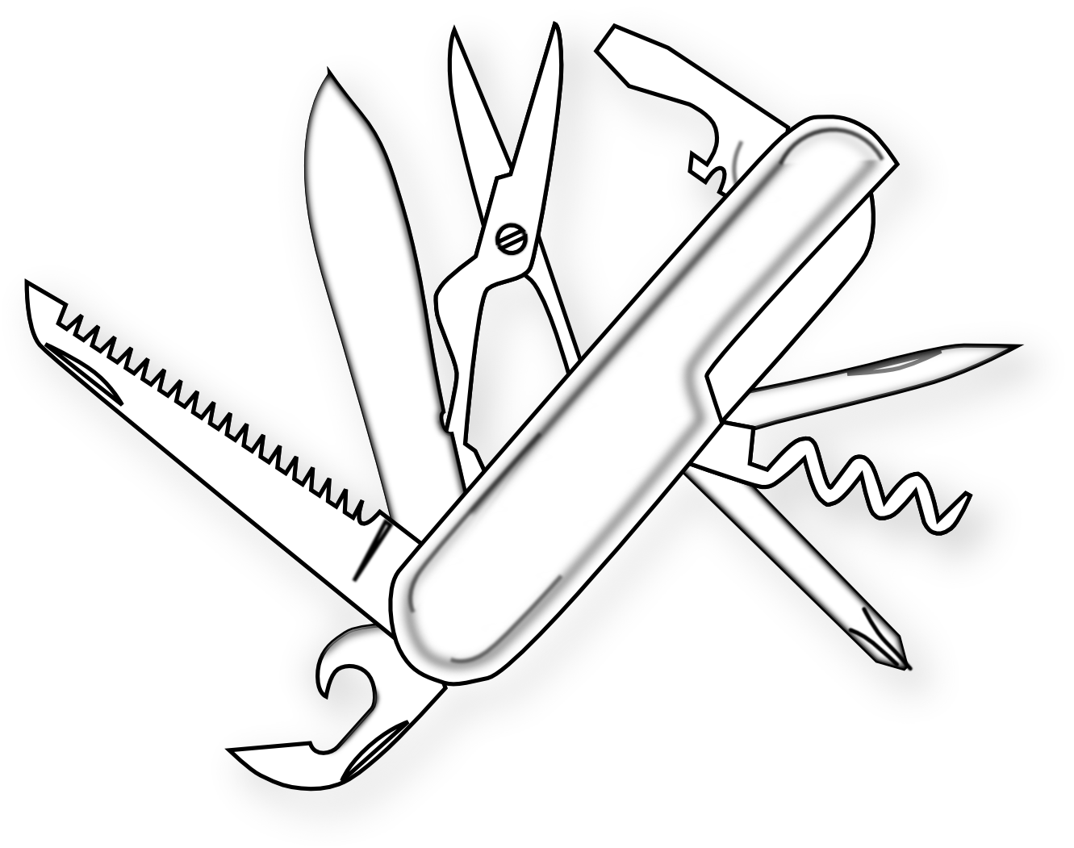
SSH – швейцарский нож системного администратора
Арутюнян Сурен
ПИПЭ 15

Slide 2
Что такое SSH?
SSH — это защищённый протокол, по которому компьютеры могут отправлять друг другу команды и данные. В нашем случае с помощью SSH можно удалённо управлять каким-нибудь компьютером: давать ему команды, исполнять на нём программы и делать всё, что позволит нам командная строка. Если удалось связаться с компьютером по SSH, то это как будто вы подключили к удалённому компьютеру свою клавиатуру.

Slide 3
Пример
Представим ситуацию: вы работаете в Москве, ваш заказчик — в Санкт-Петербурге, и у него сломался интернет-магазин на собственном сервере.
Тут два варианта: можно физически приехать в нужный город, подключить клавиатуру к серверу и исправить всё на месте. А можно подключиться к серверу удалённо по SSH и исправлять все ошибки, попивая сок у себя в квартире (в Москве).

Slide 4
Что можно сделать с помощью SSH
SSH
 | Настраивать сервер;
 | Программировать;
 | Чинить неисправности на сайте;
 | Запускать и останавливать программы, в том числе намертво зависшие;
 | Копировать файлы;
 | Управлять настройками безопасности;
SSH
 | Перезагружать компьютер;
 | Отформатировать какой-нибудь диск;
 | Устанавливать всё, что угодно;
 | Забрать файл с удалённого компьютера или закинуть туда свой файл;
 | Открыть этот файл удаленно;
 | И Т.Д.

Slide 5

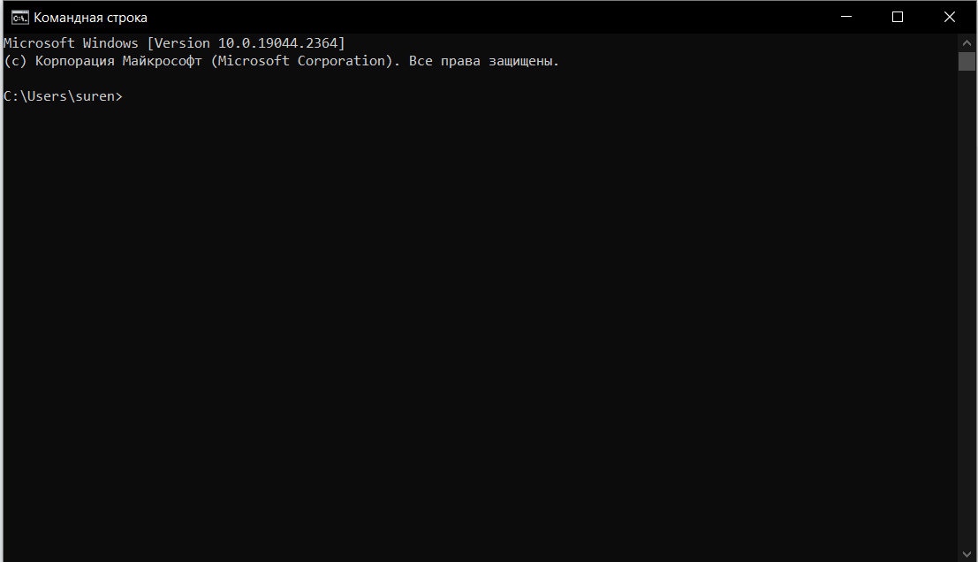
Командная строка
01
Графический интерфейс
02
Командная строка
03
Голосовой интерфейс
04
Физический интерфейс

Slide 6


SSH-соединение

Slide 7
Steampunk infographics
 | Mercury | Venus
Jupiter | Venus is the second planet from the Sun | Mercury is the smallest planet of them all
Mars | Mercury is the closest planet to the Sun | Ceres is located in the asteroid belt
Saturn | Pluto is now considered a dwarf planet | Jupiter is the biggest planet of them all
Neptune is the farthest planet from the Sun. It's also the fourth-largest planet by diameter in the Solar System

Slide 8
Steampunk infographics
 | 01 | Jupiter | Jupiter is the biggest planet in the Solar System
 | 02 | Mercury | Mercury is the smallest planet in the Solar System
 | 03 | Venus | Venus is extremely hot, even more than Mercury
 | 04 | Earth | Earth is the only planet known to harbor life

Slide 9
Steampunk infographics
Venus
Venus has a beautiful name, but also high temperatures
Mars
Despite being red, Mars is actually a cold place
Jupiter
Jupiter is the biggest planet in the Solar System
Saturn
Saturn is the second-largest planet in the Solar System

Slide 10
Steampunk infographics
Mercury
Earth
Mercury is the smallest planet in the Solar System
Earth is the only planet known to harbor life
Mars
Ceres
Saturn
Neptune
Despite being red, Mars is very cold
It's located in the main asteroid belt
Saturn is a gas giant and has rings
Neptune is very far away from us

Slide 11
Steampunk infographics
Earth
It's the only planet that harbors life
Jupiter
Jupiter doesn’t have a solid surface
Mars
Despite being red, Mars is very cold
Venus
Venus has a beautiful name

Slide 12
Steampunk infographics
Mercury
Mercury is the closest planet to the Sun
Jupiter
Venus
Jupiter is the biggest planet of them all
Venus is the second planet from the Sun
Saturn
Saturn is a gas giant and has several rings

Slide 13
Steampunk infographics
Don't do it
Mars
 | Despite being red, Mars is very cold
Mercury
 | It's the closest planet to the Sun
Do it
Venus
 | Earth is a planet that harbors life
Ceres
 | It's located in the main asteroid belt

Slide 14
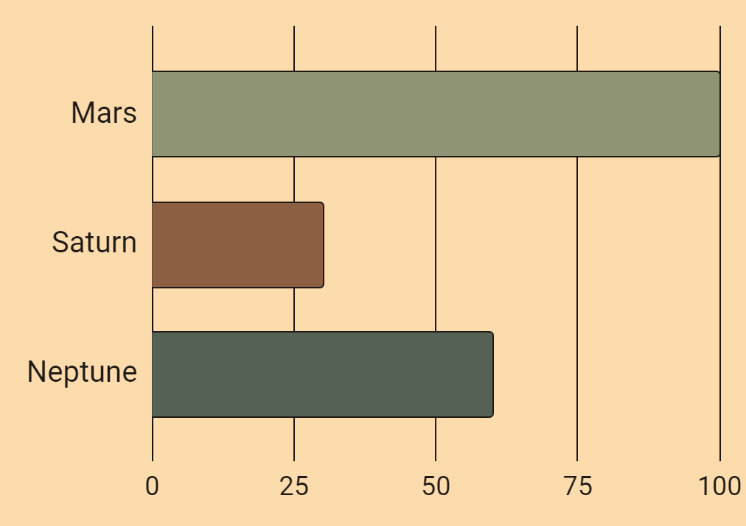
Steampunk infographics
100%
Mars
Mars is actually a very cold place
30%
Saturn
Saturn is a gas giant and has several rings
60%
Neptune
Follow the link in the graph to modify its data and then paste the new one here. For more info, click here
It’s the farthest planet from the Sun

Slide 15
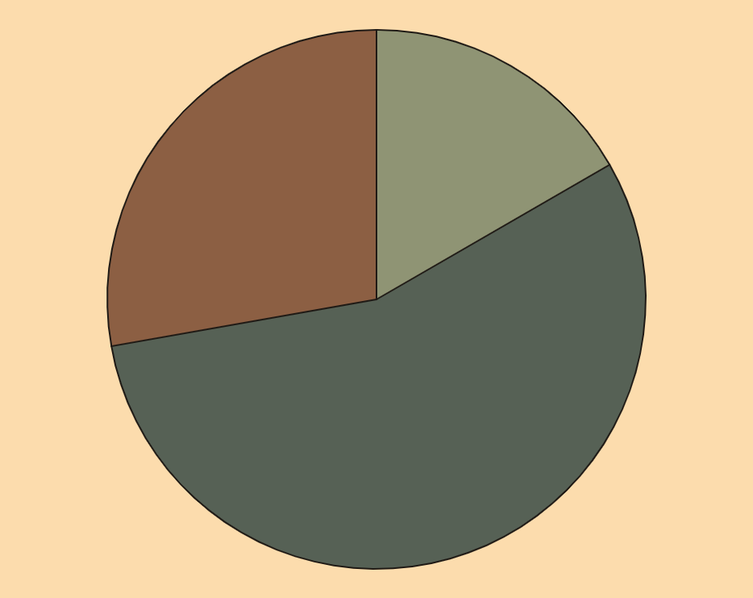
Steampunk infographics
16,7%
Neptune
27,8%
It’s far away from us
Saturn
Saturn is the ringed planet
55,6%
Jupiter
It was named after a god
Follow the link in the graph to modify its data and then paste the new one here. For more info, click here

Slide 16
Steampunk infographics
Saturn
Saturn is a gas giant and has several rings
10%
Jupiter
It’s the biggest planet in the Solar System
30%
Mars
Despite being red, Mars is a cold place
10%
Venus
Venus is the second planet from the Sun
50%

Slide 17
Steampunk infographics
December, 2xxx
Mon | Tue | Wed | Thu | Fri | Sat | Sun
 |  |  |  | 1 | 2 | 3
4 | 5 | 6 | 7 | 8 | 9 | 10
11 | 12 | 13 | 14 | 15 | 16 | 17
18 | 19 | 20 | 21 | 22 | 23 | 24
25 | 26 | 27 | 28 | 29 | 30 | 31
12/09/2XXX
12/25/2XXX
Mars is actually a cold place
Jupiter is a gas giant

Slide 18
Steampunk infographics
01
Neptune
05
Earth
It's an ice giant
Earth has life
02
Saturn
06
Pluto
It has rings
It's a dwarf planet
03
Jupiter
07
Sun
It's a gas giant
It’s a bright star
04
Mars
08
Venus
It's made of basalt
It's terribly hot

Slide 19
Steampunk infographics
Saturn
01
02
Neptune
Saturn was named after a Roman god
Neptune is very far away from the Sun
Jupiter
03
04
Earth
Jupiter doesn’t have a solid surface
Earth is the third planet from the Sun
Venus
05
06
Mercury
Venus is the second planet from the Sun
Mercury is the closest planet to the Sun

Slide 20
Steampunk infographics
Neptune
Mercury
It's the fourth-largest planet by diameter in the Solar System
Mercury is the smallest planet in the Solar System
Pluto
It's a dwarf planet
Ceres
It's in the asteroid belt
Saturn
It has several rings
Jupiter
It’s a gas giant
Mars
Mars is a cold planet
Earth
We all live on Earth

Slide 21
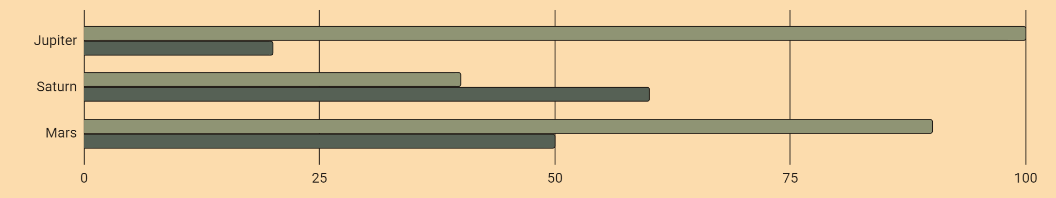
Steampunk infographics
Follow the link in the graph to modify its data and then paste the new one here. For more info, click here
Jupiter
It’s the biggest planet of them all
100 | 20
Saturn
It's a gas giant and has several rings
40 | 60
Mars
Mars is actually a very cold place
90 | 50

Slide 22
Steampunk infographics
Venus
01 | Mercury is small
02 | Venus is terribly hot
03 | Earth has life
04 | Mars is a red planet
05 | The Sun is a star
Jupiter
Saturn
It's the biggest planet of them all
Saturn was named after a Roman god
The Moon
Neptune
It’s our planet’s natural satellite
It's very far away from the Sun

Slide 23
Steampunk infographics
01
Saturn
Saturn has several rings
06
Mercury
Mercury is quite a small planet
02
Neptune
Neptune is far away from us
05
Earth
Earth is the planet with life
03
Pluto
It's considered a dwarf planet
04
Mars
Mars is full of iron oxide dust

Slide 24
Steampunk infographics
Jupiter
Despite being red, Mars is very cold
Earth is the third planet from the Sun
Pluto is now considered a dwarf planet
Neptune is very far away from us
20%
40%
30%
10%
Venus

Slide 25
Steampunk infographics
01
Jupiter
Jupiter is the biggest planet in the Solar System
Mercury is the closest planet to the Sun and the smallest in the Solar System. It was named after a Roman god
02
Mars
Despite being red, Mars is actually a cold place
03
Earth
Earth is the only planet known to harbor life

Slide 26
Steampunk infographics
01 | Mercury |  | Mercury is the closest planet to the Sun
02 | Venus |  | Venus is the second planet from the Sun
03 | Earth |  | Earth is the third planet from the Sun
04 | Mars |  | Despite being red, Mars is very cold
05 | Jupiter |  | Jupiter doesn’t have a solid surface
06 | Saturn |  | Saturn was named after a Roman god

Slide 27
Steampunk infographics
Mercury
Venus
Mars
Mercury is the closest planet to the Sun and the smallest of them all
Venus has a beautiful name and is the second planet from the Sun
Despite being red, It's actually a cold place. It’s full of iron oxide dust

Slide 28
Steampunk infographics
Mars
Earth
Venus
Mars was named after a god
It's the third planet from the Sun
Venus has a beautiful name
01
02
03

Slide 29
Steampunk infographics
Jupiter
It’s a gas giant
Mars
It's a cold place
Earth
Earth has life
Venus
Venus is very hot

Slide 30
Steampunk infographics
01
02
03
04
05
Mars
Venus
Jupiter
Neptune
Earth
It was named after a god
Venus is terribly hot
It was named after a god
It’s far away from us
It's the planet with life

Slide 31
Steampunk infographics
Venus
Mercury
Venus has a beautiful name and is the second planet from the Sun
Mercury is the closest planet to the Sun and the smallest of them all
Saturn
Neptune
Mars
Jupiter

Slide 32
Steampunk infographics
Earth
2XXX
Earth is the only planet known to harbor life
2XXX
Mars
Despite being red, Mars is actually a cold place
Venus
2XXX
It's extremely hot, even more than Mercury
2XXX
Neptune
It’s the farthest planet from the Sun

Slide 33
Steampunk infographics
Venus
01
Mercury
Venus is terribly hot, even hotter than Mercury, and its atmosphere is extremely poisonous
Saturn has rings
Mercury is very small
Pluto is a dwarf planet
Neptune is far away from us
Jupiter is a gas giant
It's the closest planet to the Sun and the smallest one in the entire Solar System
02
Earth
Earth is the third planet from the Sun and the only one that harbors life

Slide 34
Instructions for use
If you have a free account, in order to use this template, you must credit Slidesgo in your final presentation. Please refer to the next slide to read the instructions for premium users.
As a Free user, you are allowed to:
- Modify this template.
- Use it for both personal and commercial projects.
You are not allowed to:
- Sublicense, sell or rent any of Slidesgo Content (or a modified version of Slidesgo Content).
- Distribute Slidesgo Content unless it has been expressly authorized by Slidesgo.
- Include Slidesgo Content in an online or offline database or file.
- Offer Slidesgo templates (or modified versions of Slidesgo templates) for download.
- Acquire the copyright of Slidesgo Content.
For more information about editing slides, please read our FAQs or visit our blog:
https://slidesgo.com/faqs and https://slidesgo.com/slidesgo-school

Slide 35
Instructions for use (premium users)
As a Premium user, you can use this template without attributing Slidesgo.
You are allowed to:
Modify this template.
Use it for both personal and commercial purposes.
Share this template in an editable format with people who are not part of your team.
You are not allowed to:
Sublicense, sell or rent this Slidesgo Template (or a modified version of this Slidesgo Template).
Distribute this Slidesgo Template (or a modified version of this Slidesgo Template) or include it in a database or in any other product or service that offers downloadable images, icons or presentations that may be subject to distribution or resale.
Use any of the elements that are part of this Slidesgo Template in an isolated and separated way from this Template.
Register any of the elements that are part of this template as a trademark or logo, or register it as a work in an intellectual property registry or similar.
For more information about editing slides, please read our FAQs or visit our blog:
https://slidesgo.com/faqs and https://slidesgo.com/slidesgo-school

Slide 36
Infographics
You can add and edit some infographics to your presentation to present your data in a visual way.
Choose your favourite infographic and insert it in your presentation using Ctrl C + Ctrl V or Cmd C + Cmd V in Mac.
Select one of the parts and ungroup it by right-clicking and choosing “Ungroup”.
Change the color by clicking on the paint bucket.
Then resize the element by clicking and dragging one of the square-shaped points of its bounding box (the cursor should look like a double-headed arrow). Remember to hold Shift while dragging to keep the proportions.
Group the elements again by selecting them, right-clicking and choosing “Group”.
Repeat the steps above with the other parts and when you’re done editing, copy the end result and paste it into your presentation.
Remember to choose the “Keep source formatting” option so that it keeps the design. For more info, please visit our blog.

